Slide 1
We want to know…
Change LED and LED filter:
Change in fluorescence
Change in variability
Run to run
Instrument to instrument

Slide 2
Intro
Background
7 instruments
G04 (x5)
InjMold (x2)
Swap LED, LED filter
Covid
2.5 c/uL Zeptometrix NATtrol SARS-CoV-2 Stock in 1x Nasal Matrix
5 replicates on each instrument
Change LED and LED filter:
Change in fluorescence
Change in variability
Run to run
Instrument to instrument

Slide 3
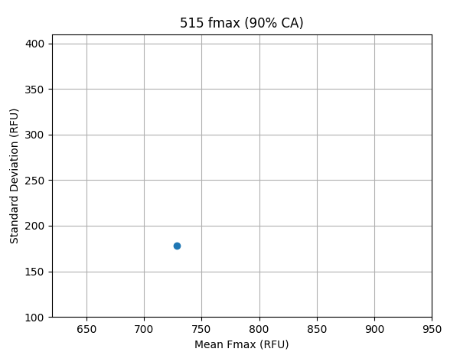
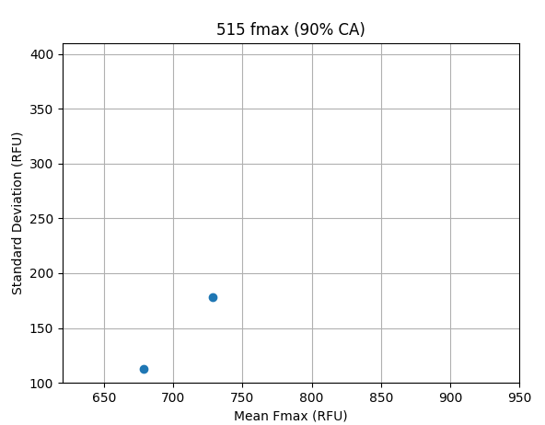
Confidence Area

Slide 4
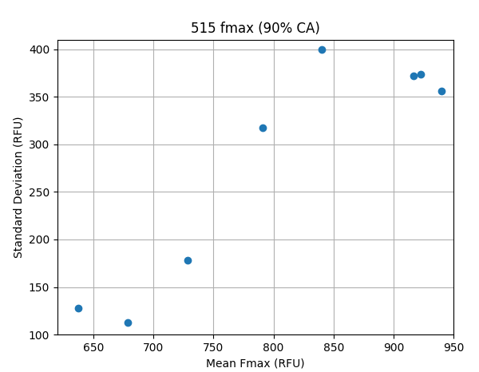
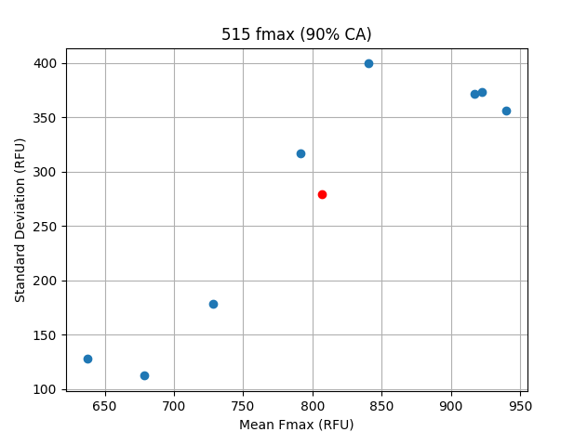
Confidence Area

Slide 5
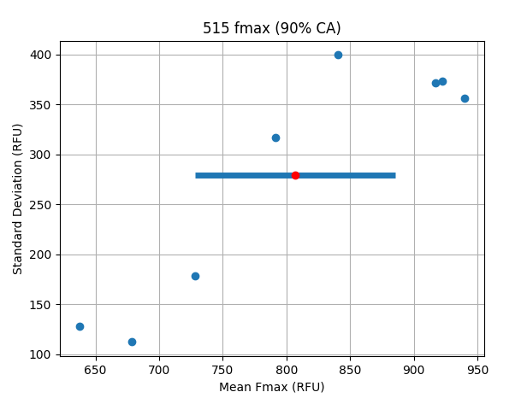
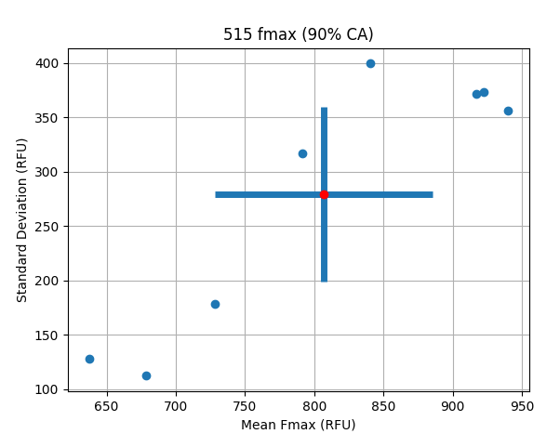
Confidence Area

Slide 6
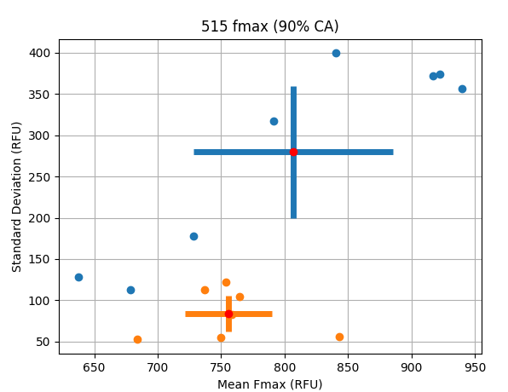
Confidence Area

Slide 7
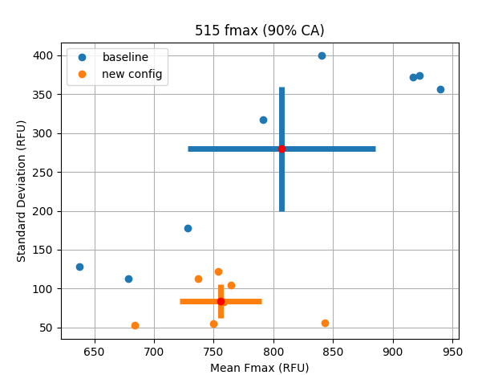
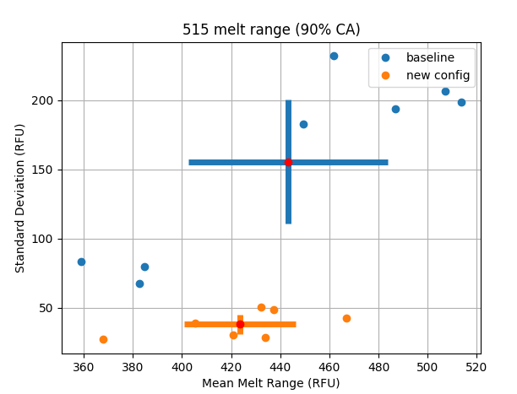
515
Fmax
Melt range

Slide 8
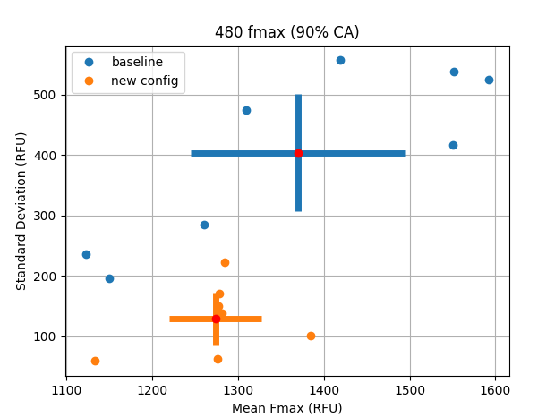
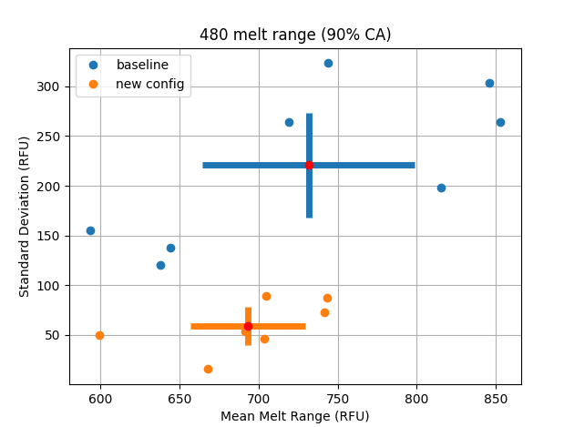
480
Fmax
Melt range

Slide 9
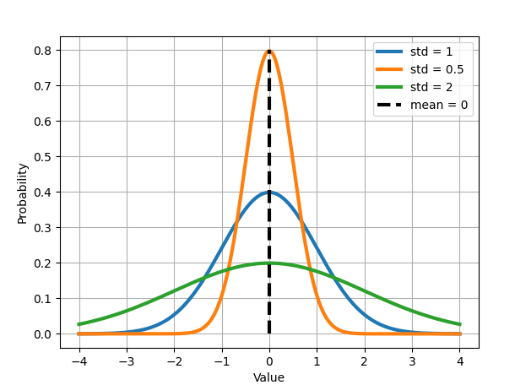
Normal Distribution

